Slide 1
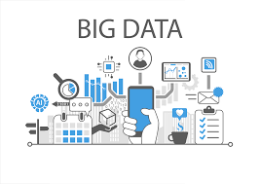
What is Big Data?
Big data refers to the large volume of structured, semi-structured,and unstructured data businesses collect daily. It is a term used to describe data that is too large and complex to be analyzed by traditional methods. The four "Vs" that characterize big data are volume, velocity, variety, and veracity.
To give an example, consider a social media platform like Facebook. Millions of people use Facebook to post, share, and interact with others daily. It generates vast data, including text, images, videos, and more. This data is too large and complex to be analyzed by traditional methods. However, big data technologies process and interpret this data easily and quickly.

Slide 2
Why Big Data?
Importance of big data
1. Cost Savings Big Data tools like Apache Hadoop, Spark, etc. bring cost-saving benefits to businesses when they have to store large amounts of data. These tools help organizations in identifying more effective ways of doing business.
2. Time-Saving Real-time in-memory analytics helps companies to collect data from various sources. Tools like Hadoop help them to analyze data immediately thus helping in making quick decisions based on the
3. Understand the market conditions Big Data analysis helps businesses to get a better understanding of market situations. For example, analysis of customer purchasing behavior helps companies to identify the products sold most and thus produces those products accordingly. This helps companies to get ahead of their competitors.
4. Social Media Listening Companies can perform sentiment analysis using Big Data tools. These enable them to get feedback about their company, that is, who is saying what about the company. Companies can use big data tools to improve their online presence.
5. Boost Customer Acquisition and Retention Customers are a vital asset on which any business depends on. No single business can achieve its success without building a robust customer base. But even with a solid customer base, the companies can’t ignore the competition in the market.
6. Solve Advertisers Problem and Offer Marketing Insights Big data analytics shapes all business operations. It enables companies to fulfill customer expectations. Big data analytics helps in changing the company’s product line. It ensures powerful marketing campaigns.
7. The driver of Innovations and Product Development Big data makes companies capable to innovate and redevelop their products.
Big Data initiatives were rated as “extremely important” to 93% of companies. Leveraging a Big Data analytics solution helps organizations to unlock the strategic values and take full advantage of their assets.
It helps organizations like To understand Where, When and Why their customers buy
Protect the company’s client base with improved loyalty programs
Seizing cross-selling and upselling opportunities
Provide targeted promotional information
Optimize Workforce planning and operations Improve inefficiencies in the company’s supply chain
Predict market trends
Predict future needs
Make companies more innovative and competitive It helps companies to discover new sources of revenuE

Slide 3
Classification of Data
Data can be classified as
• structured
• semi-structured
• unstructured
Structured Data:
• Structured data refers to any data that resides in a fixed field within a record or file.
• Having a particular Data Model.
• Meaningful data.
• Data arranged in arow and column.
• Structured data has the advantage of being easily entered, stored, queried and analysed.
• E.g.: Relational Data Base, Spread sheets.
• Structured data is often managed using Structured Query Language (SQL) Sources of Structured Data: • SQL Databases
• Spreadsheets such as Excel
• OLTP Systems
• Online forms
• Sensors such as GPS or RFID tag
• Network and Web server logs
• Medical devices

Slide 4
Unstructured Data
Semi-structured Data:
Self-describing data.
Metadata (Data about data).
Also called quiz data: data in between structured and semi structured.
It is a type of structured data but not followed data model
Data which does not have rigid structure. E.g.: E-mails, word processing software. XML and other markup language are often used to manage semi structured data.
Unstructured data can not readily classify and fit into a neat box Also called unclassified data. Which does not confirm to any data model.
Business rules are not applied.
Indexing is not required.
E.g.: photos and graphic images, videos, streaming instrument data, webpages, Pdf files, PowerPoint presentations, , blog entries, wikis and word processing documents.

Slide 5
Characteristics of Big Data (5 Vs of Big Data)
1. Volume: Volume refers to the sheer size of the ever-exploding data of the computing world. It raises the question about the quantity of data collected from different sources over the Internet
2.Velocity: Velocity refers to the processing speed. It raises the question of at what speed the data is processed. The speed is measured by the use of the data in a specific time period.In Big Data velocity data flows in from sources like machines, networks, social media, mobile phones etc.There is a massive and continuous flow of data. This determines the potential of data that how fast the data is generated and processed to meet the demands.
3. Variety: Variety refers to the types of data. In Big Data the raw data always collected in variety. The raw data can be structured, unstructured, and semi structured. This is because the data is collected from various sources.It also refers to heterogeneous sources.
4. Veracity
Indicates the quality, accuracy, and reliability of data.
Deals with uncertainty, noise, and inconsistency in data.
Example:
Duplicate data
Incomplete or incorrect data
5. Value
Refers to the usefulness of data in decision-making.
The goal of Big Data analytics is to extract meaningful insights.
Example:
Customer behavior analysis
Fraud detection

Slide 6
History and Evolution of Big Data
1. Traditional Data Era (1960s – 1990s)
Data stored in files and relational databases (RDBMS).
Mostly structured data.
Limited scalability and expensive hardware.
Used mainly by governments and large enterprises.
Limitation: Could not handle large volumes or unstructured data.
2. Internet & Digital Explosion Era (1995 – 2005)
Growth of Internet, emails, websites, and e-commerce.
Data volume increased rapidly.
Multimedia data (images, videos) became common.
Limitation: Traditional databases failed to scale.
3. Hadoop & Distributed Computing Era (2005 – 2012)
Companies like Google, Yahoo, Facebook faced massive data growth.
Google MapReduce & GFS inspired Apache Hadoop.
Enabled distributed storage and batch processing.
Key Technologies:
Hadoop
HDFS
MapReduce
4. NoSQL & Big Data Ecosystem Era (2012 – 2016)
Emergence of NoSQL databases to handle flexible schemas.
Support for semi-structured and unstructured data.
Hadoop ecosystem expanded.
Examples:
MongoDB
Cassandra
HBase
Hive, Pig

Slide 7
5. Real-Time & In-Memory Processing Era (2016 – 2019)
Businesses needed real-time insights.
Batch processing alone was insufficient.
Apache Spark replaced MapReduce for faster processing.
Technologies:
Apache Spark
Kafka
Spark Streaming
6. Cloud-Based Big Data Era (2019 – 2022)
Shift from on-premise to cloud platforms.
Big Data became scalable, cost-effective, and service-based.
Pay-as-you-go model adopted widely.
Cloud Platforms:
AWS (EMR, S3)
Microsoft Azure (Synapse, Data Factory)
Google Cloud (BigQuery)
7. Modern Big Data Era (2023 – Present)
This is the latest evolution.
Big Data + AI & Machine Learning
Big Data is tightly integrated with AI/ML models.
Used for predictive analytics, recommendations, automation.
Lakehouse Architecture
Combines Data Lake + Data Warehouse.
Solves performance and governance issues.
Examples:
Delta Lake
Apache Iceberg

Slide 8
Business Intelligence (BI)
BI refers to technologies and approaches used to gather, store, analyze, and provide access to data to help business users make better decisions. It involves extracting structured data from internal sources, transforming and loading it into data warehouses or data marts, and presenting it in reports and dashboards for analysis. The goal is to support operational and strategic decision making through monitoring performance metrics, understanding past trends, and gauging business health.

Slide 9
Key Differences Between Big Data vs Business Intelligence
Key Differences | Big Data | Business Intelligence
Data Volume and Variety | Deals with large and complex unstructured data | Deals with structured data typically stored in data warehouses
Data Processing | Processes and analyzes large volumes of unstructured data using technologies such as Hadoop, Spark, and NoSQL databases | Analyzes structured data and creates reports and visualizations using BI tools
Data Storage | Uses distributed file systems such as HDFS to store data | Uses data warehousing to store structured data
Analysis Techniques | Uses MapReduce and machine learning to analyze unstructured data | Uses OLAP and data mining techniques to examine structured data
Time Sensitivity | Typically real-time or near real-time as it deals with high velocity data | Analysis is typically done on historical data and may not be time-sensitive
Business Goals | Used to discover new insights and opportunities | Monitors performance and makes informed decisions

Slide 10
Pros and Cons of Business Intelligence
Pros | Cons
Improved Decision-making: BI tools can provide businesses with valuable insights into their performance, improving their decision-making process. | Limited Scope: BI tools are typically used to analyze structured data and may not be suitable for examining unstructured data.
Historical Analysis: BI analysis is typically done on historical data, which can help businesses identify trends and patterns over time. | Time Sensitivity: BI analysis is typically done on historical data and may not be time-sensitive.
Easy to Use: Many BI tools are user-friendly and do not require specialized skills or expertise. | Integration Challenges: Integrating BI tools with existing systems can require significant effort and resources.
Standardization: BI tools provide a standardized way of analyzing data, which can help businesses ensure consistency and accuracy. | Data Quality: BI analysis is only as good as the quality of the data being interpreted. Data quality issues can impact the accuracy of analysis results.
Scalability: BI tools can scale up or down as needed to meet the changing needs of the business. | Cost: BI tools can be expensive. Businesses must weigh the costs against the potential benefits.
Cost Savings: BI analysis can help businesses identify cost savings opportunities by specifying areas of inefficiency or waste. | Limited Flexibility: BI tools may be unable to accommodate ad hoc analysis or changing business needs, limiting their usefulness in dynamic business environments.

Slide 11
DATAWAREHOUSE
A traditional data warehouse is a comprehensive system that brings together data from different sources within an organization. Its primary role is to act as a centralized data repository used for analytical and reporting purposes.

Slide 12
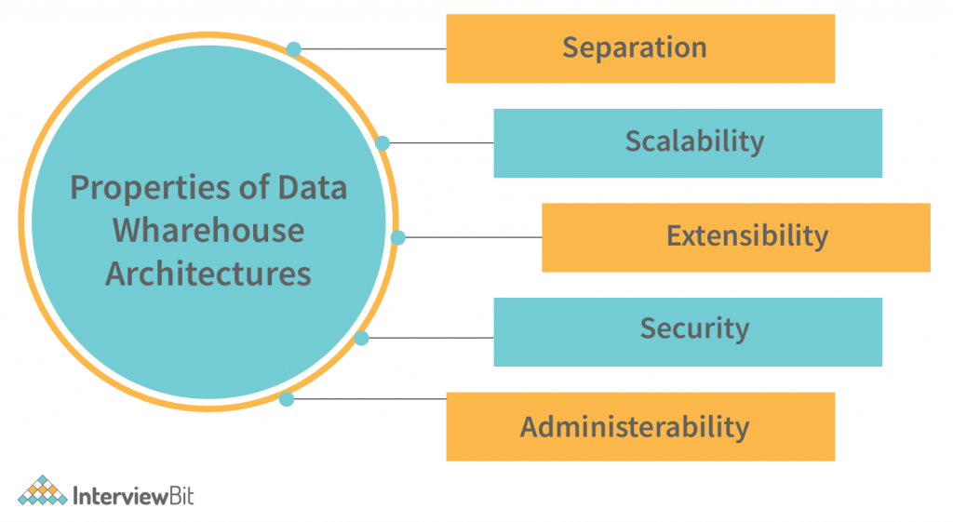
Properties of Datawarehouse
The scalability of the solution should be demonstrated by the ability to process a huge volume of data and stream it to different destinations, at high speed, in various formats. The data stream should be processed and presented in the required format, at the right time and location, with the minimum impact to the existing infrastructure. The data stream must be protected and managed with the highest level of confidentiality and integrity. The size of the data stream and the rate at which the data is being generated must be determined by the business requirements, and the available hardware and software resources must be utilized to the fullest extent possible.
The architecture should be extensible; new functionality can be implemented in an existing service by extending the service’s APIs. For example, an insurance company could extend their customer service platform to provide a new feature that allows customers to obtain a personalized quote based on their preferences. Newer technologies, such as artificial intelligence, can be implemented in an existing service by extending the service’s APIs. For example, an insurance company could extend their customer service platform to provide a new feature that allows customers to obtain a personalized quote based on their preferences.
Data security is a critical aspect of the data governance strategy. Data security controls at the source include establishing data access controls and data encryption. Data security controls at the perimeter include data security policies and monitoring access to the data.
It should be simple and straightforward, and users should be able to work with the data in an efficient and effective manner. Data Warehouse management should be easy to understand and implement.

Slide 13
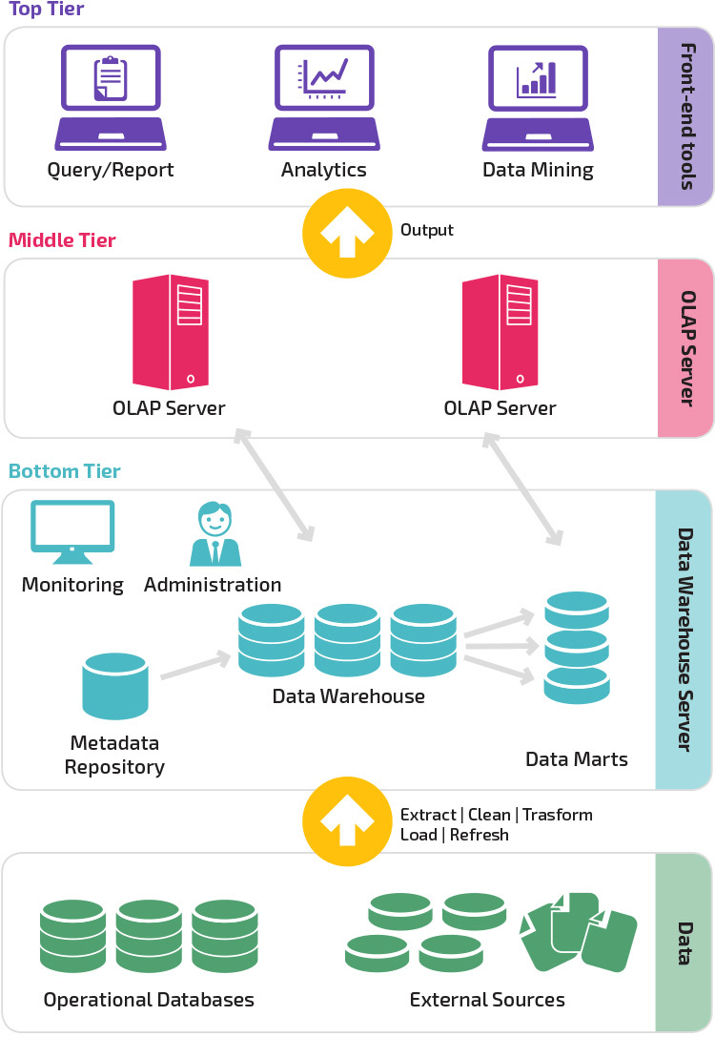
The 3-Tier Architecture Of Traditional Data Warehouses

Slide 14
1. Bottom Tier – Data Warehouse Server (Data Layer)
This layer is responsible for data collection, storage, and management.
Components:
Operational Databases Day-to-day transactional systems (ERP, CRM, banking systems, etc.).
External Sources Data from files, APIs, third-party systems, logs, documents, etc.
ETL Process (Extract | Clean | Transform | Load | Refresh)
Extract: Collects data from multiple sources
Clean: Removes errors and inconsistencies
Transform: Converts data into a common format
Load: Stores data into the warehouse
Refresh: Periodically updates data
Data Warehouse Central repository that stores integrated, historical, and subject-oriented data.
Data Marts Subsets of the data warehouse created for specific departments (Sales, Finance, HR).
Metadata Repository Stores information about data (schema, source, transformation rules).
Monitoring & Administration Ensures performance, security, backup, and maintenance.
2. Middle Tier – OLAP Server (Processing Layer)
This layer performs data analysis and aggregation.
OLAP (Online Analytical Processing) Server:
Supports complex queries and multidimensional analysis
Enables operations like slice, dice, drill-down, roll-up
Improves query performance by pre-computing summaries
3. Top Tier – Front-End Tools (Presentation Layer)
This layer is used by end users for decision-making.
Tools Included:
Query & Reporting Tools – Generate standard and ad-hoc reports
Analytics Tools – Trend analysis, KPIs, dashboards
Data Mining Tools – Pattern discovery, prediction, forecasting

Slide 15
What Is Big Data Analytics
Big data analytics uses advanced analytics on large structured and unstructured data collections to produce valuable business insights. It is used widely across industries as varied as healthcare, education, insurance, artificial intelligence, retail, and manufacturing to understand what’s working and what’s not to improve processes, systems, and profitability.
It comprises vast amounts of structured and unstructured data, which can offer important insights when analytics are applied. Big data analytics does this quickly and efficiently so that healthcare providers can use the information to make informed, life-saving diagnoses.

Slide 16
Classification of Analytics
1. Descriptive analytics
Descriptive analytics refers to data that can be easily read and interpreted. This data helps create reports and visualise information that can detail company profits and sales.
Example: During the pandemic, a leading pharmaceutical company conducted data analysis on its offices and research labs. Descriptive analytics helped them identify consolidated unutilised spaces and departments, saving the company millions of pounds.
2. Diagnostic analytics
Diagnostic analytics helps companies understand why a problem occurred. Big data technologies and tools allow users to mine and recover data that helps dissect an issue and prevent it from happening in the future.
Example: An online retailer’s sales have decreased even though customers continue to add items to their shopping carts. Diagnostic analytics helped to understand that the payment page was not working correctly for a few weeks.
3. Predictive analytics
Predictive analytics looks at past and present data to make predictions. With artificial intelligence (AI), machine learning, and data mining, users can analyse the data to predict market trends.
Example: In the manufacturing sector, companies can use algorithms based on historical data to predict if or when a piece of equipment will malfunction or break down.
4. Prescriptive analytics
Prescriptive analytics solves a problem, relying on AI and machine learning to gather and use data for risk management.
Example: Within the energy sector, utility companies, gas producers, and pipeline owners identify factors that affect the price of oil and gas to hedge risks

Slide 17
Why Is Big Data Analytics Important?
Big data analytics offers businesses a competitive advantage and drives significant value across multiple aspects of operations. Firstly, analyzing big data enables businesses to gain deep customer insights.
By analyzing vast amounts of customer data, including demographics, purchasing behavior, and preferences, businesses can create personalized marketing campaigns, improve customer segmentation, and deliver tailored experiences. This leads to increased customer satisfaction, loyalty, and ultimately higher revenue.
Additionally, big data analysis is crucial in optimizing business processes and improving operational efficiency. Businesses can identify bottlenecks, streamline operations, and reduce costs by analyzing data from various sources, such as supply chains, manufacturing processes, and customer interactions.
It enables predictive maintenance, where potential equipment failures can be anticipated, minimizing downtime and maximizing productivity. Moreover, big data analytics helps businesses make data-driven decisions by providing accurate and timely insights. This ensures that strategic planning, resource allocation, and risk management are backed by solid evidence, leading to better outcomes and improved business performance.Big data analytics shapes all business operations. It enables companies to fulfill customer expectations. Big data analytics helps in changing the company’s product line. It ensures powerful marketing campaigns

Slide 18
Benefits of Big Data Analytics
Improved Decision Making: By analyzing large volumes of data from diverse sources, organizations can gain deeper insights into customer behavior, market trends, and operational performance. These insights enable informed decision making, leading to better strategic planning and resource allocation.
Enhanced Customer Experience: Big data analytics allows businesses to understand customer preferences, sentiment, and behavior. This knowledge enables personalized marketing campaigns, product recommendations, and higher customer satisfaction and loyalty.
Optimized Operations and Efficiency: Analyzing data from various aspects of operations, such as supply chain, manufacturing, and logistics, help identify inefficiencies and bottlenecks. This optimization leads to reduced costs, improved productivity, and streamlined processes.
Innovative Product Development: Big data analytics enables organizations to gather customer feedback and usage data which often forms the basis of creating innovative products and services that align with market demands and give you a competitive edge.
Effective Risk Management: With big data analytics, businesses can proactively identify and mitigate potential risks, whether financial, security-related, or compliance-related. This risk management approach helps safeguard against losses and reputational damage.
Competitive Advantage: Organizations that harness big data analytics effectively gain a competitive edge by being better equipped to adapt to market changes, predict trends, and stay ahead of competitors.
Personalized Health Care: In the health care sector, big data analytics can help medical professionals tailor treatment plans based on a patient's medical history, genetic data, and lifestyle, resulting in more effective and personalized care.
Data-Driven Marketing: Big data analytics empowers marketers to measure the effectiveness of their campaigns, optimize marketing spend, and target specific customer segments with personalized messaging, leading to better ROI.
Improved Public Services: Governments can utilize big data analytics to optimize public services, predict and prevent public health issues, optimize traffic flow, and make data-driven policy decisions to benefit citizens.

Slide 19
Few Top Analytical Tools
1. Tableau
Tableau is a data visualization tool that helps you simplify the presentation of raw data, making it more understandable when shared with other professionals within your organization. Data analysts like using Tableau because it doesn’t require special technical knowledge or programming skills to get started.
Companies making use of Tableau include Cisco, LinkedIn, and Lenovo..
2. Microsoft Power BI
Power BI is a platform of cloud-based business intelligence applications and services. Data analysts use it to pull large quantities of information from various sources, including Excel, and transform data to create visuals that help companies make sense of the data.
Power BI is popular among data analysts because they can create data models and reports to share within an organization.
Businesses creating solutions with Power BI include Hitachi Solutions, Adobe, and Toyota.
3. SAS
SAS (Statistical Analysis Software) is a software suite used to retrieve, analyze, and report statistical data. Data analysts use SAS to extract data from databases and raw data files to identify and analyze various data patterns that have meaning for the company. It’s popular among data analysts because SAS requires no other special technical skills besides some SQL familiarity.
Organizations that use SAS include Honda, Kia, and Office Depot..
4. Erwin
The Erwin platform includes data modeling tools used by data analysts to map out the details of databases within an organization. It’s useful for data analysts who need to reverse-engineer an existing database to get a sense of the information it contains.
Companies currently using Erwin include Fidelity International and CenturyLink.
Companies can request a free demo of Erwin or purchase licenses by contacting a company sales representative.

Slide 20
What is a NoSQL database?
NoSQL, also referred to as “not only SQL” or “non-SQL”, is an approach to database design that enables the storage and querying of data outside the traditional structures found in relational databases
Instead of the typical tabular structure of a relational database, NoSQL databases, house data within one data structure, such as JSON document. Since this non-relational database design does not require a schema, it offers rapid scalability to manage large and typically unstructured data sets.
NoSQL is also type of distributed database, which means that information is copied and stored on various servers, which can be remote or local. This ensures availability and reliability of data. If some of the data goes offline, the rest of the database can continue to run.

Slide 21
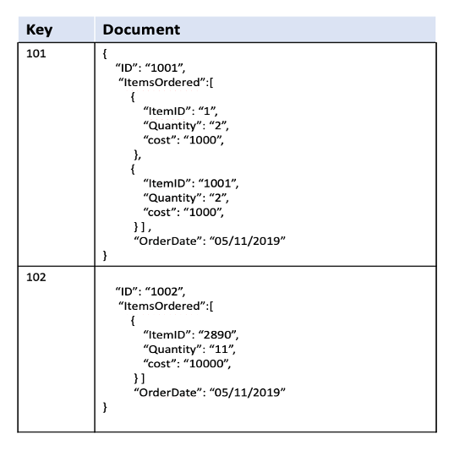
Types of NoSQL databases
Document-oriented databases
A document-oriented database stores data in documents similar to JSON (JavaScript Object Notation) objects. Each document contains pairs of fields and values. The values can typically be a variety of types, including things like strings, numbers, booleans, arrays, or even other objects. A document database offers a flexible data model, much suited for semi-structured and typically unstructured data sets. They also support nested structures, making it easy to represent complex relationships or hierarchical data.
Examples of document databases are MongoDB and Couchbas
A NoSQL database manages information using any of these primary data models:
Key-value databases
A key-value store is a simpler type of database where each item contains keys and values. Each key is unique and associated with a single value. They are used for caching and session management and provide high performance in reads and writes because they tend to store things in memory. Examples are Amazon DynamoDB and Redis. A simple view of data stored in a key-value database is given below.
Example:
Key: user:12345
Value: {"name": "foo bar", "email": "foo@bar.com", "designation": "software developer"}

Slide 22
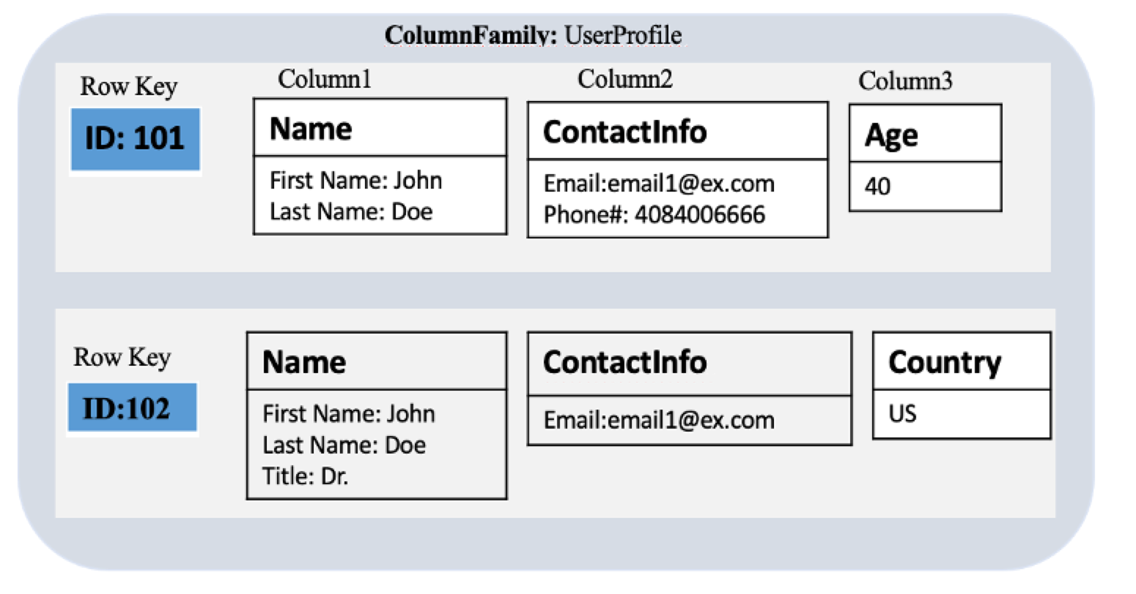
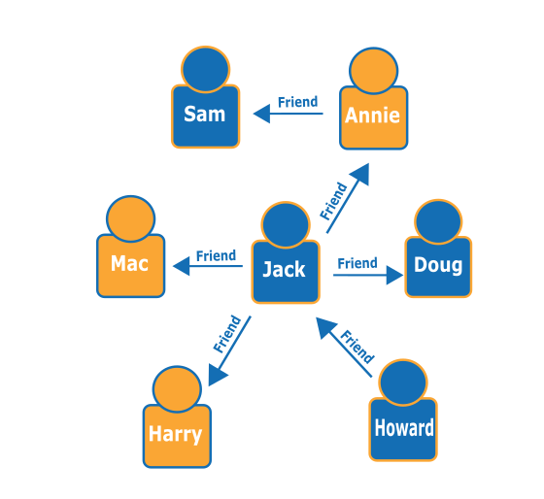
Wide-column store
These databases store information in columns, enabling users to access only the specific columns they need without allocating additional memory on irrelevant data. This database tries to solve for the shortcomings of key-value and document stores, but since it can be a more complex system to manage, it is not recommended for use for newer teams and projects. Apache HBase and Apache Cassandra are examples of open-source, wide-column databases. Apache HBase is built on top of Hadoop Distributed Files System that provides a way of storing sparse data sets, which is commonly used in many big data applications.
Graph store
A graph database stores data in the form of nodes and edges. Nodes typically store information about people, places, and things (like nouns), while edges store information about the relationships between the nodes. They work well for highly connected data, where the relationships or patterns may not be very obvious initially Graph databases are used for storing and managing a network of connections between elements within the graph. .
Use Cases: Social networks, recommendation systems, fraud detection
Examples:
Neo4j
OrientDB
Amazon Neptune
Graph databases

Slide 23
Advantages of NoSQL
Each type of NoSQL database has strengths that make it better for specific use cases. However, they all share the following advantages for developers and create the framework to provide better service customers, including:
Cost-effectiveness: It is expensive to maintain high-end, commercial RDBMS. They require the purchase of licenses, trained database managers, and powerful hardware to scale vertically. NoSQL databases allow you to quickly scale horizontally, better allocating resources to minimize costs.
Flexibility: Horizontal scaling and a flexible data model also mean NoSQL databases can address large volumes of rapidly changing data, making them great for agile development, quick iterations, and frequent code pushes.
Replication: NoSQL replication functionality copies and stores data across multiple servers. This replication provides data reliability, ensuring access during down time and protecting against data loss if servers go offline.
Speed: NoSQL enables faster, more agile storage and processing for all users, from developers to sales teams to customers. Speed also makes NoSQL databases generally a better fit for modern, complex web applications, e-commerce sites, or mobile applications

Slide 24
UNIT2

Slide 25
Introducing hadoop
Hadoop is an open-source software framework that is used for storing and processing large amounts of data in a distributed computing environment. It is designed to handle big data and is based on the MapReduce programming model, which allows for the parallel processing of large datasets. Its framework is based on Java programming with some native code in C and shell scripts.
Hadoop is designed to process large volumes of data (Big Data) across many machines without relying on a single machine. It is built to be scalable, fault-tolerant and cost-effective. Instead of relying on expensive high-end hardware, Hadoop works by connecting many inexpensive computers (called nodes) in a cluster.

Slide 26
Why Hadoop?
Why Not RDBMS?
Traditional RDBMS (Relational Database Management Systems) are not suitable for Big Data due to several limitations.
Limitations of RDBMS
Limited Scalability
Scales vertically (adding more CPU/RAM), which is expensive.
High Cost
Licensing and high-end hardware increase cost.
Fixed Schema
Schema must be defined in advance (schema-on-write).
Not flexible for changing data formats.
Cannot Handle Unstructured Data
Mainly supports structured tabular data.
Performance Issues with Big Data
Slow when handling very large datasets.
Single Point of Failure
Traditional RDBMS systems lack built-in fault tolerance.
Hadoop is used to store and process very large volumes of data (Big Data) efficiently.
Handles Huge Data Volumes
Designed for terabytes and petabytes of data.
Scalability
Easily scalable by adding more machines (horizontal scaling).
Cost-Effective
Uses commodity hardware, reducing infrastructure cost.
Fault Tolerance
Data is replicated across multiple nodes.
System continues to work even if a node fails.
Supports All Data Types
Handles structured, semi-structured, and unstructured data.
Parallel Processing
Uses MapReduce to process data in parallel, improving performance.
High Throughput
Optimized for batch processing and large datasets.

Slide 27
RDBMS | Hadoop
Processing in RDBMS can be done through querying using SQL. | MapReduce or Spark is used for batch processing
RDBMS is a great option for the OLTP environment. | Hadoop is suitable for BIG data environment.
Transformed and aggregated data can be stored in RDBMS. | It has the ability to store a large amount of data.
It is costly and depends upon the license of the software. | It is an open-source software and is available for free.
Data is stored in a database which is based on rows and columns. Data can be easily retrieved and manipulated in RDBMS. | Hadoop is an open-source software which can be used for running applications and storing data.
RDBMS is used to process structured data only. | Hadoop can be used for the processing of unstructured and structured data.
Data integrity is high. | Data integrity is low.
RDBMS is less scalable in comparison to Hadoop. | Hadoop is highly scalable.
RDBMS requires data normalization. | Hadoop does not need data normalization.
RDBMS has a static type of schema. | Hadoop has a dynamic type of schema.

Slide 28
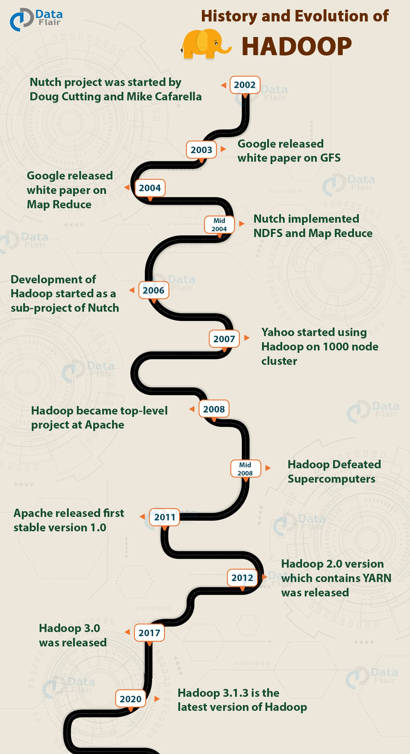
HISTORY OF HADOOP
2002
It all started in the year 2002 with the Apache Nutch project.
In 2002, Doug Cutting and Mike Cafarella were working on Apache Nutch Project that aimed at building a web search engine that would crawl and index websites.
After a lot of research, Mike Cafarella and Doug Cutting estimated that it would cost around $500,000 in hardware with a monthly running cost of $30,000 for a system supporting a one-billion-page index.
This project proved to be too expensive and thus found infeasible for indexing billions of webpages. So they were looking for a feasible solution that would reduce the cost.
2003
Meanwhile, In 2003 Google released a search paper on Google distributed File System (GFS) that described the architecture for GFS that provided an idea for storing large datasets in a distributed environment. This paper solved the problem of storing huge files generated as a part of the web crawl and indexing process. But this is half of a solution to their problem

Slide 29
2004
In 2004, Nutch’s developers set about writing an open-source implementation, the Nutch Distributed File System (NDFS).
In 2004, Google introduced MapReduce to the world by releasing a paper on MapReduce. This paper provided the solution for processing those large datasets. It gave a full solution to the Nutch developers.
Google provided the idea for distributed storage and MapReduce. Nutch developers implemented MapReduce in the middle of 2004.
2006
The Apache community realized that the implementation of MapReduce and NDFS could be used for other tasks as well. In February 2006, they came out of Nutch and formed an independent subproject of Lucene called “Hadoop” (which is the name of Doug’s kid’s yellow elephant).
As the Nutch project was limited to 20 to 40 nodes cluster, Doug Cutting in 2006 itself joined Yahoo to scale the Hadoop project to thousands of nodes cluster.
2007
In 2007, Yahoo started using Hadoop on 1000 nodes cluster.
2008
In January 2008, Hadoop confirmed its success by becoming the top-level project at Apache.
By this time, many other companies like Last.fm, Facebook, and the New York Times started using Hadoop.
Hadoop Defeated supercomputers
In April 2008, Hadoop defeated supercomputers and became the fastest system on the planet by sorting an entire terabyte of data.
In November 2008, Google reported that its Mapreduce implementation sorted 1 terabyte in 68 seconds.
In April 2009, a team at Yahoo used Hadoop to sort 1 terabyte in 62 seconds, beaten Google MapReduce implementation.

Slide 30
Various Release of Hadoop
2011 – 2012
On 27 December 2011, Apache released Hadoop version 1.0 that includes support for Security, Hbase, etc.
On 10 March 2012, release 1.0.1 was available. This is a bug fix release for version 1.0.
On 23 May 2012, the Hadoop 2.0.0-alpha version was released. This release contains YARN.
The second (alpha) version in the Hadoop-2.x series with a more stable version of YARN was released on 9 October 2012.
2017 – now
On 13 December 2017, release 3.0.0 was available
On 25 March 2018, Apache released Hadoop 3.0.1, which contains 49 bug fixes in Hadoop 3.0.0.
On 6 April 2018, Hadoop release 3.1.0 came that contains 768 bug fixes, improvements, and enhancements since 3.0.0.
Later, in May 2018, Hadoop 3.0.3 was released.
On 8 August 2018, Apache 3.1.1 was released.
Hadoop 3.1.3 is the latest version of Hadoop.

Slide 31
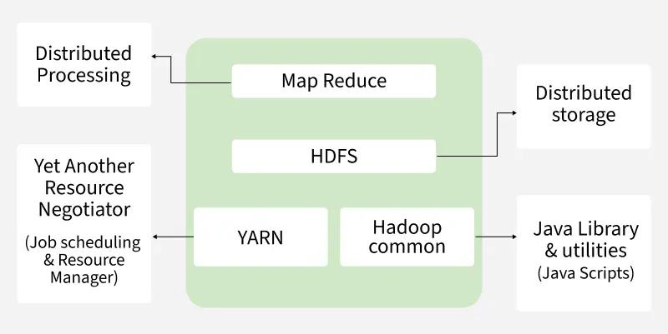
Hadoop - Architecture
Hadoop is an open-source Java framework that stores and processes massive data using clusters of inexpensive (commodity) hardware. Based on Google’s MapReduce programming model, it enables distributed, parallel processing. Big companies like Facebook, Yahoo, Netflix and eBay use Hadoop to handle large-scale data efficiently.
Components of Hadoop Architecture
Hadoop Architecture Mainly consists of 4 components:
MapReduce
HDFS (Hadoop Distributed File System)
YARN (Yet Another Resource Negotiator)
Common Utilities or Hadoop Common

Slide 32
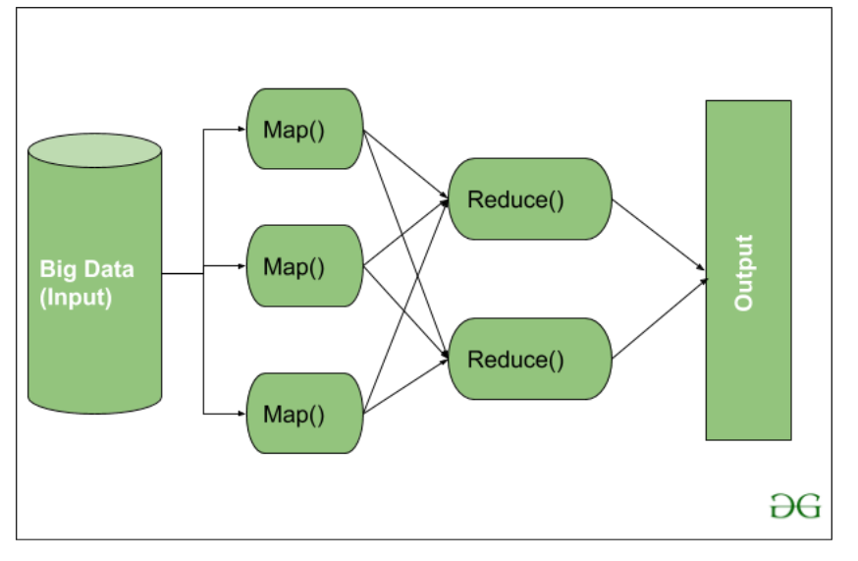
1. MapReduce
MapReduce is a data processing model in Hadoop that runs on YARN. It enables fast, distributed and parallel processing by dividing tasks into two phases Map and Reduce making it efficient for handling large-scale data.
MapReduce Workflow: workflow begins when input data is split into key-value pairs by Map() function. These are then grouped by key and processed by Reduce() function for tasks like sorting or aggregation. The final output is written to HDFS.
Note: Core aggregation often happens in the Reducer, but preprocessing and filtering are ideally done in the Mapper to optimize performance.
Map Task Components:
RecordReader: reads input data and converts it into key-value pairs, with keys as location info and values as actual data.
Mapper: processes each pair and outputs zero or more new key-value pairs.
Combiner (optional): acts as a mini-reducer to group Mapper output and reduce data transfer before shuffling.
Partitioner: assigns key-value pairs to Reducers using key.hashCode() % numberOfReducers.
Reduce Task Components:
Shuffle and Sort: transfers intermediate key-value pairs from Mappers to Reducers and sorts them by key. Shuffling begins as soon as some Mappers finish.
Reducer: processes grouped key-value pairs, performing tasks like aggregation or filtering based on logic.
OutputFormat: writes final results to HDFS using a RecordWriter, typically storing each record as a key-value line.

Slide 33
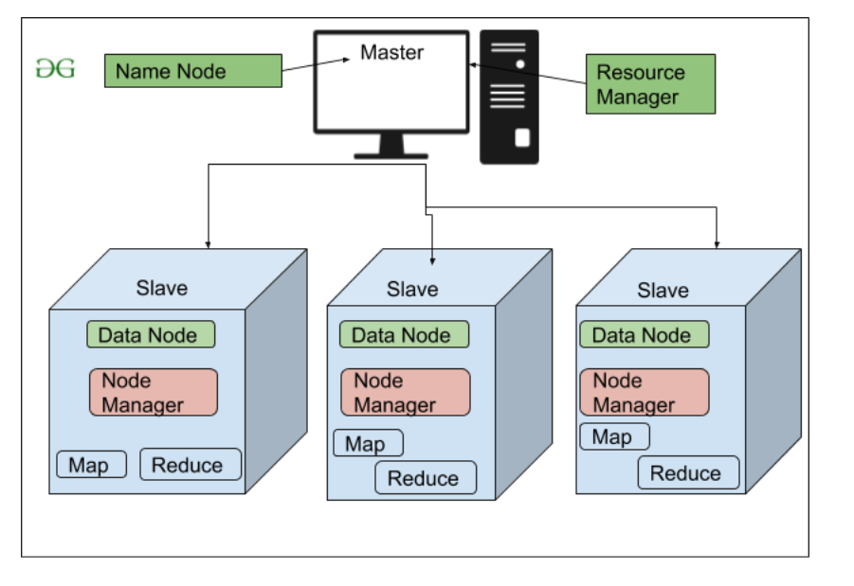
2. HDFS
HDFS (Hadoop Distributed File System) is Hadoop’s primary storage system, built for high-throughput access to large datasets. It runs on inexpensive commodity hardware and stores data in large blocks to optimize performance. HDFS ensures fault tolerance and high availability across the cluster.
HDFS Architecture Components:
NameNode (Master Node): The master node in HDFS that stores metadata (not actual data), manages file operations and directs clients to nearest DataNode for efficient access.
DataNode (Slave Node): Stores actual data blocks, serves read/write requests and reports to NameNode. Supports replication (default 3) for fault tolerance and scales storage and performance with more nodes.

Slide 34
3. YARN (Yet Another Resource Negotiator)
YARN is resource management layer in Hadoop ecosystem. It allows multiple data processing engines like MapReduce, Spark and others to run and share cluster resources efficiently.
It handles two core responsibilities:
Job Scheduling: Splits large tasks into smaller jobs, assigns them to nodes and manages priorities, dependencies and execution.
Resource Management: Allocates and monitors cluster resources (CPU, memory, etc.) needed for job execution.
Components of Yarn:
ResourceManager: Master node that manages global resource allocation.
NodeManager: Slave node that monitors resources on individual nodes.
ApplicationMaster: Manages lifecycle of each individual application/job.
4. Hadoop Common (Common Utilities)
Hadoop Common, also known as Common Utilities, includes core Java libraries and scripts required by all components in a Hadoop ecosystem such as HDFS, YARN and MapReduce.
These libraries offer core functionalities such as:
File system and I/O operations
Configuration and logging
Security and authentication
Network communication
File Block In HDFS: In HDFS data is always stored in the form of blocks. By default, each block is 128MB in size, although this value can be manually configured depending on the use case (commonly increased to 256MB or more in modern systems).
2. Replication In HDFS:
HDFS replication ensures data availability and fault tolerance by storing multiple copies of each block.
Default Replication Factor: 3 (configurable in hdfs-site.xml)
If a file is split into 4 blocks, with a replication factor of 3: 4 blocks × 3 replicas = 12 total blocks
Designed for commodity hardware, where failures are common—replication prevents data loss. While it increases storage usage, reliability is prioritized over space efficiency.
3. Rack Awareness:
A rack is a group of machines (typically 30–40) in a Hadoop cluster. Large clusters have many racks. Rack Awareness helps NameNode to:
Choose the nearest DataNode for faster read/write operations.
Reduce network traffic by minimizing inter-rack data transfer

Slide 35
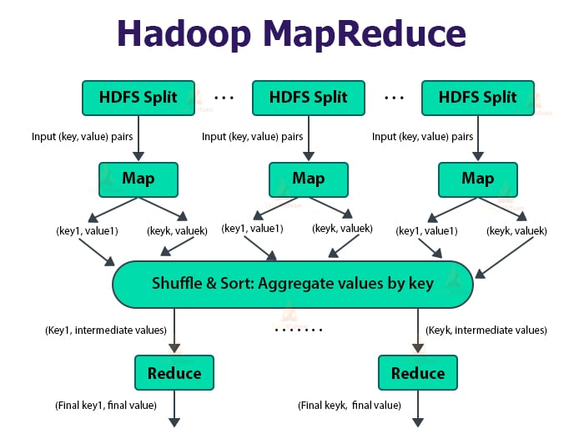
Processing data with Hadoop
The diagram illustrates the data processing flow in Hadoop using the MapReduce programming model. It shows how large input data stored in HDFS is processed in parallel to produce final results.
1. HDFS Split (Input Data)
The input dataset stored in HDFS is divided into multiple splits.
Each split is a logical chunk of data processed independently.
Every split is represented as input key–value pairs (e.g., <offset, line> in a text file).
Purpose: Enables parallel processing of large datasets

Slide 36
2. Map Phase
Each HDFS split is processed by a Mapper.
The Map function transforms input key–value pairs into intermediate key–value pairs.
Example:
Input : (key, value)
Output : (key1, value1), (keyk, valuek)
Purpose: Filtering, transformation, or extraction of useful data.
3. Shuffle and Sort Phase
Intermediate outputs from all mappers are:
Shuffled: Transferred across the network
Sorted: Grouped based on keys
All values belonging to the same key are aggregated together.
Example:
(key1, [v1, v2, v3])
(keyk, [v1, v2])
Purpose: Ensures that all data with the same key reaches the same Reducer.
4. Reduce Phase
Each Reducer processes a group of keys and their associated values.
Performs aggregation operations such as sum, count, max, min, etc.
Produces final key–value pairs.
Example:
(key1, final value)
(keyk, final value)
Purpose: Generates summarized or aggregated results.
5. Final Output
The output of Reducers is written back to HDFS.
Stored as part files (e.g., part-r-00000).

Slide 37
Hadoop Use Cases
1. Hadoop for Telecom Industry
Let’s look at a couple of examples from the telecom industry where Big Data and Hadoop solved a critical business problem. China Mobil Guangdong company has an extensive network of customers. Not only do they have to maintain billions of mobile call records, but it is essential to businesses that they have real-time access to call records and billing information of the customers. Traditional database management systems couldn’t scale in this scenario, so they came up with a cost-effective solution using Hadoop. With the help of Intel tech, they used HBase to store billions of call record details. As per an estimate, nearly 30 Terabytes of data are added to their database on a monthly basis. Another example of Big Data management in the telecom industry comes from Nokia. They store and analyze the massive volume of data from their manufactured mobile phones.
To paint a fair picture of Nokia’s Big Data, they manage 100 TB of structured data along with 500+ TB of semi-structured data. Hadoop Distributed Framework System provided by Cloudera manages a variety of Nokia’s data and processes it on a scale of petabytes.
2. Hadoop in Retail Sector
With the ever-increasing interaction over social media and retail channels, customers are comparing products, services, and prices for multiple online and store retailers. With this kind of behaviour, consumers can quickly shift from one retailer to another, which makes it absolutely essential for companies in the retail sector to tap this information and keep track of the leaks in the sales funnel. It is necessary for a retail company to tap retail big data analytics, using Hadoop to understand customer’s purchase behavior. Big Data and Hadoop are being used in the retail industry for the following use cases:
Retail analytics for inventory forecasting.
Retail analytics for dynamic pricing of products.
Retail analytics for supply chain efficiency.
Retail analytics for targeted and customized promotion and marketing.
Retail analytics in fraud detection and prevention

Slide 38
3. Hadoop in the Healthcare Sector:. The Healthcare industry leverages Big Data for curing diseases, reducing medical costs, predicting and managing epidemics, and maintaining the quality of human life by keeping track of large-scale health indexes and metrics. The big data generated in the healthcare sector is mainly due to patient record keeping and regulatory requirements. McKinsey projected that efficient usage of Big Data and Hadoop in the healthcare industry can reduce data warehousing expenses by $300-$500 billion globally. The data generated by electronic health devices are difficult to analyze using traditional database management systems. Complexity and volume of the healthcare data is the primary driving force behind the transition from legacy systems to Hadoop in the healthcare industry. Using Hadoop on such a scale of data helps in easy and quick data representation, database design, clinical decision analytics, data querying, and fault tolerance.
4. Hadoop in the Financial Sector:
After the economic recession, most of the financial institutions and national monetary associations started maintaining a single Hadoop Cluster containing more than petabytes of financial data aggregated from multiple enterprise and legacy database systems. Along with aggregating, banks and financial institutions started pulling in other data sources - such as customer call records, chat and weblogs, email correspondence, and others.
When such an unprecedented scale of data is analyzed with the assistance of Hadoop, MapReduce, and techniques like sentiment analysis, text processing, pattern matching, and graph creating; banks were able to identify the same customers across different sources along with accurate risk assessment. Predicting market behaviour is another classic problem in the financial sector. Different market sources such as stock exchanges, banks, revenue, and proceeds department, securities market - hold a massive volume of data themselves but their performance is interdependent.

Slide 39
YARN
YARN stands for Yet Another Resource Negotiator for Hadoop. Originally developed for Hadoop 2.0, YARN improved the MapReduce implementation and made it possible for Hadoop to handle a greater variety of data processing tasks. In simpler terms, YARN is the means by which clusters, resources, and jobs are managed in Hadoop. This means that the Hadoop can accommodate various data processing engines such as Interactive SQL, real-time streaming, and batch processing besides MapReduce thus expanding the opportunities for use of the platform.

Slide 40
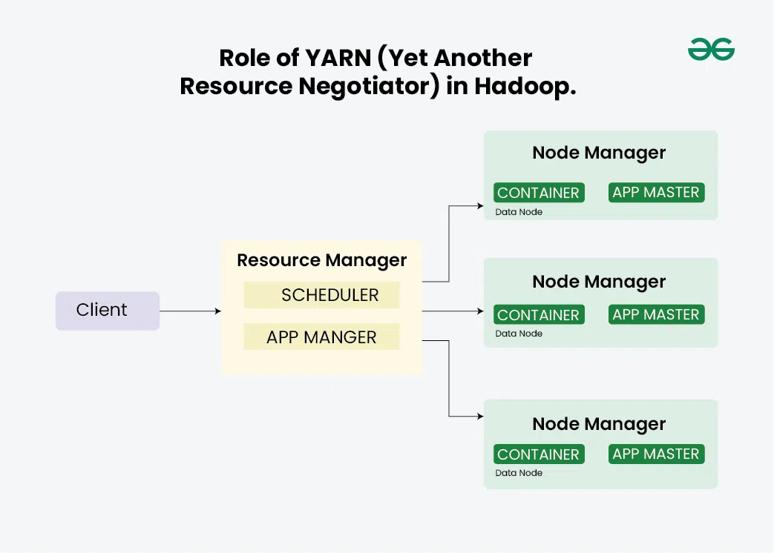
YARN's architecture
YARN's architecture comprises three main components:
Resource Manager (RM): Acts as the master daemon, managing and allocating cluster resources. It comprises two main parts:
Scheduler: Allocates resources based on application requirements and policies.
Application Manager: Manages job submissions and coordinates with Node Managers.
Node Manager: It is an application that is executed in the data nodes to coordinate the running of containers.
Application Master (AM): This is the component that is tasked with negotiating with the Resource Manager and either the Node Manager(s) to launch and monitor the tasks. It has a data computation framework provided by the Resource Manager and a per-node slave Node Manager. The Application Master is included in the application framework package.

Slide 41
Role of YARN (Yet Another Resource Negotiator) in Hadoop(IMPORTANCE OF YARN)
YARN (Yet Another Resource Negotiator) which is a core part of Hadoop that helps in boosting the architecture by effectively coordinating the resources and job scheduling . Here are the key roles of YARN in Hadoop:Here are the key roles of YARN in Hadoop:
Resource Management:
Dynamic Allocation: YARN employs adequate strategies for distribution of resources the cluster CPU, memory, disk to a number of applications based on need.
Centralized Management: It balances the resources in the Hadoop cluster and also avoids the conflict of resources within the control system.
Job Scheduling:
Flexible Scheduling: In YARN, there are different Scheduling policies that are offered to the users such as FIFO, Capacity Scheduler, Fair Scheduler which helps in proper scheduling of the workload throughout the processing interface.
Decoupling from MapReduce: Compared to using the concept of a job, YARN provides for more flexible use of resources by the system, as well as the separation of task scheduling from resource allocation, enabling Hadoop to work with frameworks other than MapReduce, including Apache Spark, Apache Flink, and Apache Tez.
Scalability and Flexibility:
Multi-application Support: YARN also authorizes multiple applications to run-on the same cluster and thus made Hadoop scalable and flexible.
Efficient Cluster Utilization: With this setup, it allows the various processing engines to run thereby improving the general utilization of the cluster.
Improved Performance:
Optimal Resource Usage: This frees up the rest of the nodes for resource provisioning to applications as needed without wasting resources hence improving the performance of the system.
Enhanced Application Management: YARN has ApplicationMaster that is responsible for processing resource allocation and activity tracking and monitoring that apply to the particular application, which are helpful when it comes to the efficient creation and management of tasks relative to the end application

Slide 42
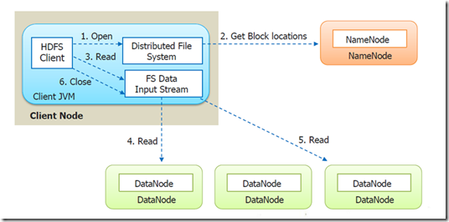
Anatomy of File Read and Write in HDFS Anatomy of File Read
Let’s suppose a Client (a HDFS Client) wants to read a file from HDFS.
Step 1: First the Client will open the file by giving a call to open() method on FileSystem object, which for HDFS is an instance of DistributedFileSystem class.
Step 2: DistributedFileSystem calls the Namenode, using RPC (Remote Procedure Call), to determine the locations of the blocks for the first few blocks of the file. For each block, the NameNode returns the addresses of all the DataNode's that have a copy of that block. Client will interact with respective DataNode'sto read the file. NameNode also provide a token to the client which it shows to data node for authentication.
The DistributedFileSystem returns an object of FSDataInputStream(an input stream that supports file seeks) to the client for it to read data from FSDataInputStream in turn wraps a DFSInputStream, which manages the datanode and namenode I/O
Step 3: The client then calls read() on the stream. DFSInputStream, which has stored the DataNode addresses for the first few blocks in the file, then connects to the first closest DataNode for the first block in the file.
Step 4: Data is streamed from the DataNode back to the client, which calls read() repeatedly on the stream.
Step 5: When the end of the block is reached, DFSInputStream will close the connection to the DataNode , then find the best DataNode for the next block. This happens transparently to the client, which from its point of view is just reading a continuous stream.
Step 6: Blocks are read in order, with the DFSInputStream opening new connections to datanodes as the client reads through the stream. It will also call the namnode to retrieve the datanode locations for the next batch of blocks as needed. When the client has finished reading, it calls close() on the FSDataInputStream.

Slide 43
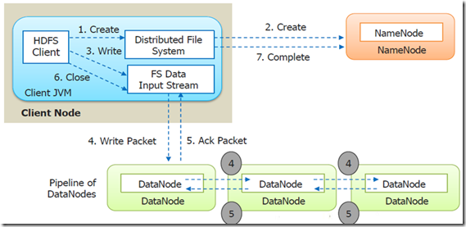
Anatomy of File Write
Step 1: The client creates the file by calling create() method on DistributedFileSystem.
Step 2: DistributedFileSystem makes an RPC call to the namenode to create a new file in the filesystem’s namespace, with no blocks associated with it.
The namenode performs various checks to make sure the file doesn’t already exist and that the client has the right permissions to create the file. If these checks pass, the namenode makes a record of the new file; otherwise, file creation fails and the client is thrown an IOException. TheDistributedFileSystem returns an FSDataOutputStream for the client to start writing data to.
Step 3: As the client writes data, DFSOutputStream splits it into packets, which it writes to an internal queue, called the data queue. The data queue is consumed by the DataStreamer, which is responsible for asking the namenode to allocate new blocks by picking a list of suitable datanodes to store the replicas. The list of datanodes forms a pipeline, and here we’ll assume the replication level is three, so there are three nodes in the pipeline. TheDataStreamer streams the packets to the first datanode in the pipeline, which stores the packet and forwards it to the second datanode in the pipeline.
Step 4: Similarly, the second datanode stores the packet and forwards it to the third (and last) datanode in the pipeline.
Step 5: DFSOutputStream also maintains an internal queue of packets that are waiting to be acknowledged by datanodes, called the ack queue. A packet is removed from the ack queue only when it has been acknowledged by all the datanodes in the pipeline.
Step 6: When the client has finished writing data, it calls close() on the stream.
This action flushes all the remaining packets to the datanode pipeline and waits for acknowledgments before contacting the namenode to signal that the file is complete The namenode already knows which blocks the file is made up of , so it only has to wait for blocks to be minimally replicated before returning successfully.

Slide 44
Question Bank from module1
What is Big Data? Explain the characteristics of Big Data.
Define big data, explain the challenges with big data
explain the characteristics of big data with a real-time scenario. Next question, elaborate the significance of five V's of big data, volume, velocity, variety, veracity, value with suitable example
with the neat diagram explain the HDFS architecture along with its component.
define big data and analytics. Explain the classification of analytics and signify the importance of big data analytics
explain the anatomy of HDFS file read and write.
discuss the evolution of big data, highlighting right from traditional data era to modern big data era
highlight big data analytics applications with one real-time case study.
Explain components of Hadoop with example. Next question, advantages of MapReduce.
application of MapReduce. disadvantage of MapReduce.
Hadoop use cases.
processing data with Hadoop.
, role of Yarn in Hadoop, importance of Yarn in Hadoop.
, MapReduce architecture.
, history of Hadoop.
difference between RDBMS and Hadoop.
features of big data.
, types of big data. Next question,
explain five top analytic tools that are currently being used in industry, highlighting the importance of each tool along with its application.
define SQL, explain the different types of NoSQL database. Next question, advantages and limitations of NoSQL.
With a neat diagram explain HDFS architecture.

Slide 45
Discuss the Evolution of Big Data
What are the core components of Hadoop? Explain in brief its each of its components.
Highlight Big Data Analytics applications with one case study
With a neat diagram explain HDFS architecture.
Implement word count program in Hadoop
Give HDFS Commands to perform the following operations
i) To get the list of directories and files at the root of HDFS
hdfs dfs -ls /
ii) To create a directory (say, sample) in HDFS
hdfs dfs -mkdir /sample
iii) To copy a file from local file system to HDFS
hdfs dfs -put localfile.txt /sample/
(Replace localfile.txt with the actual local file name)
iv) To display the contents of an HDFS file on console
hdfs dfs -cat /sample/localfile.txt

Slide 46
Word Count Program in Hadoop using Python
Mapper program
import sys
for line in sys.stdin:
line = line.strip()
words = line.split()
for word in words:
print(f"{word}\t1")
Reducer Program
import sys
current_word = None
current_count = 0
for line in sys.stdin:
line = line.strip()
word, count = line.split('\t')
count = int(count)
if current_word == word:
current_count += count
else:
if current_word:
print(f"{current_word}\t{current_count}")
current_word = word
current_count = count
# Print last word count
if current_word == word:
print(f"{current_word}\t{current_count}")
Hadoop MapReduce Program to Count Number of Lines
Mapper program
import sys
for line in sys.stdin:
print(1)
Reducer Program
import sys
count = 0
for line in sys.stdin:
count += int(line.strip())
print(count)

Slide 47
Map Reduce Programming
What is MapReduce?
MapReduce is a programming model and framework within the Hadoop ecosystem that enables efficient processing of big data by automatically distributing and parallelizing the computation. It consists of two fundamental tasks: Map and Reduce.
In the Map phase, the input data divides into smaller chunks and processes independently in parallel across multiple nodes in a distributed computing environment. Each chunk transforms or “maps” into key-value pairs by applying a user-defined function. The output of the Map phase is a set of intermediate key-value pairs.
The Reduce phase follows the Map phase. It gathers the intermediate key-value pairs generated by the Map tasks, performs data shuffling to group together pairs with the same key, and then applies a user-defined reduction function to aggregate and process the data. The output of the Reduce phase is the final result of the computation

Slide 48
Advantages of using MapReduce
MapReduce can define mapper and reducer in several different languages using Hadoop streaming.
MapReduce facilitates automatic parallelization and distribution, reducing the time required to run programs.
MapReduce provides fault tolerance by re-executing, writing map output to a distributed file system, and restarting failed map or reducer tasks.
Processing of data using MapReduce is a cost-effective solution.
MapReduce processes large volumes of unstructured data very quickly.
Using HDFS and HBase security, Map Reduce ensures data security by allowing only approved users to access data stored in the system.
MapReduce programming utilizes a simple programming model to handle tasks more efficiently and quickly and is easy to learn.
MapReduce is flexible and works with several Hadoop languages to handle and store data.

Slide 49
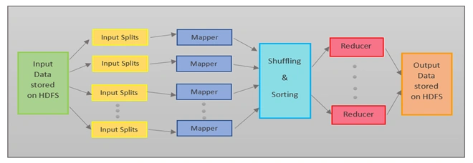
MapReduce Architecture
Map Reduce example process has the following phases:
Input Splits
Mapping
Shuffling
Sorting
Reducing

Slide 50
Input Splits
MapReduce splits the input into smaller chunks called input splits, representing a block of work with a single mapper task.
Mapping
The input data is processed and divided into smaller segments in the mapper phase, where the number of mappers is equal to the number of input splits. RecordReader produces a key-value pair of the input splits using TextFormat, which Reducer later uses as input. The mapper then processes these key-value pairs using coding logic to produce an output of the same form.
Shuffling
In the shuffling phase, the output of the mapper phase is passed to the reducer phase by removing duplicate values and grouping the values. The output remains in the form of keys and values in the mapper phase. Since shuffling can begin even before the mapper phase is complete, it saves time.
Sorting
Sorting is performed simultaneously with shuffling. The Sorting phase involves merging and sorting the output generated by the mapper. The intermediate key-value pairs are sorted by key before starting the reducer phase, and the values can take any order. Sorting by value is done by secondary sorting.
Reducing
In the reducer phase, the system reduces the intermediate values from the shuffling phase to produce a single output value that summarizes the entire dataset. The process then uses HDFS to store the final output.

Slide 51

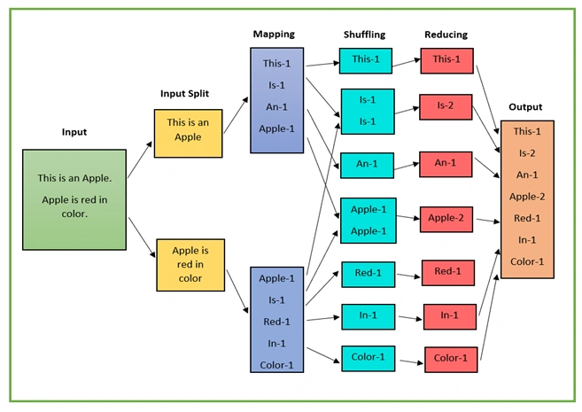
Map Reduce Example

Slide 52
Map Reduce Example
The input data divides into multiple segments and then processes in parallel to reduce processing time. In this case, we will divide the input data into two input splits to distribute work over all the map nodes.
The Mapper counts the number of times each word occurs from input splits in the form of key-value pairs where the key is the word, and the value is the frequency.
For the first input split, it generates 4 key-value pairs: This, 1; is, 1; an, 1; apple, 1; and for the second, it generates 5 key-value pairs: Apple, 1; is, 1; red, 1; in, 1; color.
It is followed by the shuffle phase, in which the values are grouped by keys in the form of key-value pairs. Here we get a total of 6 groups of key-value pairs.
The same reducer handles all key-value pairs with the same key.
Combine all the words present in the data into a single output during the reducer phase. The output shows the frequency of each word.
Here in the example, we get the final output of key-value pairs as This, 1; is, 2; an, 1; apple, 2; red, 1; in, 1; color, 1.
The record writer writes the output key-value pairs from the reducer into the output files, and by default, HDFS stores the final output data.

Slide 53
Limitations of MapReduce
Map Reduce example also faces some limitations, and they are as follows:
MapReduce is a low-level programming model which involves a lot of writing code.
The batch-based processing nature of MapReduce makes it unsuitable for real-time processing.
It does not support data pipelining or overlapping of Map and Reduce phases.
Task initialization, coordination, monitoring, and scheduling take up a large chunk of MapReduce’s execution time and reduce its performance.
MapReduce cannot cache the intermediate data in memory, thereby diminishing Hadoop’s performance.

